Slide 1
Программирования на Java: Продолжение
7-1

Slide 2

Библиотека Swing
7-2

Slide 3
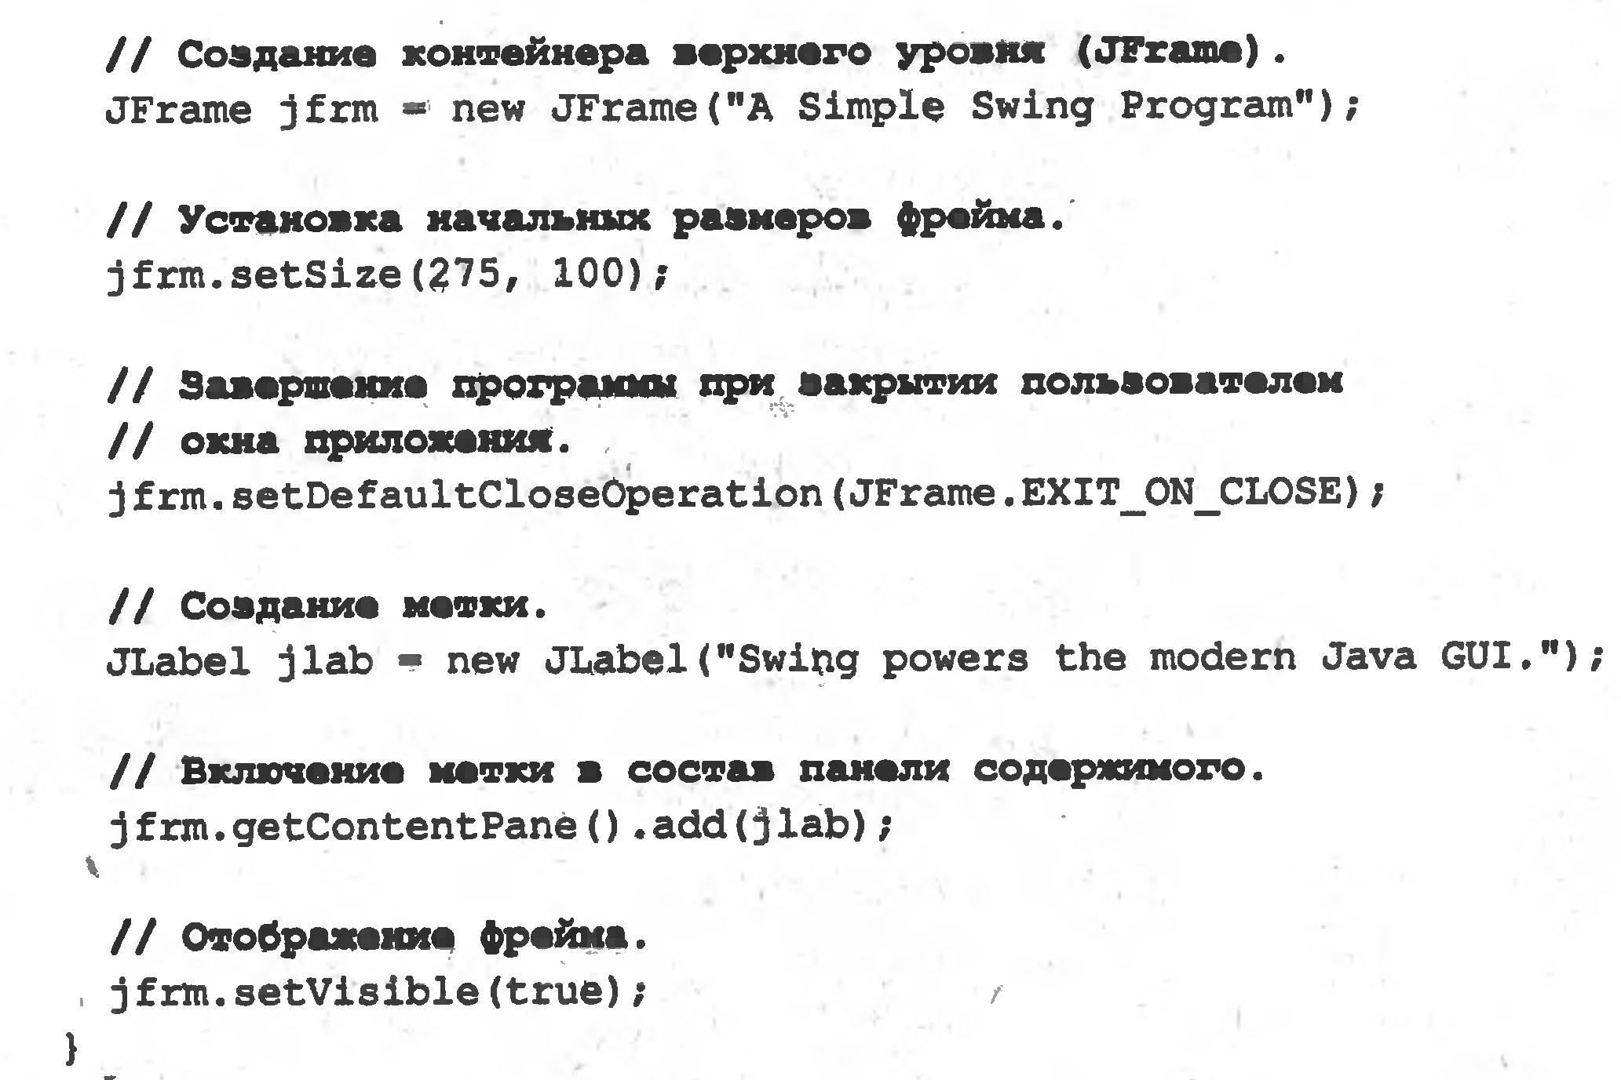
Библиотека Swing
import javax.swing.JFrame;
public class SimpleSwing {
public static void main(String[] args) {
JFrame jfrm = new JFrame("Simple Swing");
jfrm.setSize(250, 300);
jfrm.setDefaultCloseOperation(JFrame.EXIT_ON_CLOSE);
jfrm.setVisible(true);
}
}
7-3

Slide 4
Java AWT (Abstract Window Toolkit)
java.awt
Class GridLayout
The GridLayout class is a layout manager that lays out a container's components in a rectangular grid. The container is divided into equal-sized rectangles, and one component is placed in each rectangle
Java AWT
Color Class
The Color class is a part of Java Abstract Window Toolkit(AWT) package
Constructors of Color Class
Color(int r, int g, int b) : Creates a opaque color with specified RGB components(values are in range 0 – 255)
7-4

Slide 5
Java AWT (Abstract Window Toolkit)
java.awt
Class GridLayout
The GridLayout class is a layout manager that lays out a container's components in a rectangular grid. The container is divided into equal-sized rectangles, and one component is placed in each rectangle
Java AWT
Color Class
The Color class is a part of Java Abstract Window Toolkit(AWT) package
Constructors of Color Class
Color(int r, int g, int b) : Creates a opaque color with specified RGB components(values are in range 0 – 255)
7-5

Slide 6
События от МЫШИ
Mouse Events
a mouse button is pressed
a mouse button is released
a mouse button is clicked (pressed and released)
the mouse cursor enters the unobscured part of component's geometry
the mouse cursor exits the unobscured part of component's geometry
Mouse Motion Events
the mouse is moved
the mouse is dragged
7-6

Slide 7
Интерфейс MouseListener, класс MouseAdapter
java.awt.event
Interface MouseListener
Modifier and Type | Method and Description
void | mouseClicked(MouseEvent e) Invoked when the mouse button has been clicked (pressed and released) on a component.
void | mouseEntered(MouseEvent e) Invoked when the mouse enters a component.
void | mouseExited(MouseEvent e) Invoked when the mouse exits a component.
void | mousePressed(MouseEvent e) Invoked when a mouse button has been pressed on a component.
void | mouseReleased(MouseEvent e) Invoked when a mouse button has been released on a component.
28. Изменить цвет!!!
7-7

Slide 8
Интерфейс MouseMotionListener
java.awt.event
Interface Interface MouseMotionListener
Modifier and Type | Method and Description
void | mouseDragged(MouseEvent e) Invoked when a mouse button is pressed on a component and then dragged.
void | mouseMoved(MouseEvent e) Invoked when the mouse cursor has been moved onto a component but no buttons have been pushed.
7-8

Slide 9
29. Рисование мышью
30. JList
7-9

